Slide 1
The UCW’s mission is to love God; foster Christian commitment, faithfulness, and spirituality; and promote respect and love for all God’s creation.

Slide 2
As a UCW we hope to provide ideas this year of Bold Discipleship and are planning to put together an event later this year, hopefully in person and using Zoom so that we can reach as many people as possible, so if you know of a building where we can meet that has internet access and might be available I would appreciate hearing from you.
My email is valerienicksonucw1@gmail.com

Slide 3
Celebrations
The 25th Anniversary “Called to Respond” was held in 1987 at the University of Waterloo
https://www.youtube.com/watch?v=v_Fht6V_BvE
The 35th Anniversary “Rejoice and Risk” was held in 1997 at McMaster University, Hamilton, Ontario
(there was no YouTube for this year)

Slide 4
Celebrations
The 40th Anniversary “Side by Side” was held in 2002 in Winnipeg, Manitoba
https://www.youtube.com/watch?v=mvY8SacrTHs
The 45th Anniversary “We Are One” was held in 2007 in Corner Brook, Newfoundland and Labrador
https://www.youtube.com/watch?v=kF5Ongpe2fI

Slide 5
Celebrations
The 50th Anniversary “Our Tapestry of Love” was held in 2012 in Ancaster, Ontario
https://www.youtube.com/watch?v=Nwy0Nh8IivE
The 55th Anniversary “Celebrating Spirit” was held in 2017 in Vancouver, British Columbia
http://bit.ly/2jtfo80

Slide 6
Celebrations
The 60th Anniversary “Continuing in Hope” is planned for 2022 in Sydney Nova Scotia
There are currently 250 women registered to attend 5 of those are from our Region

Slide 7
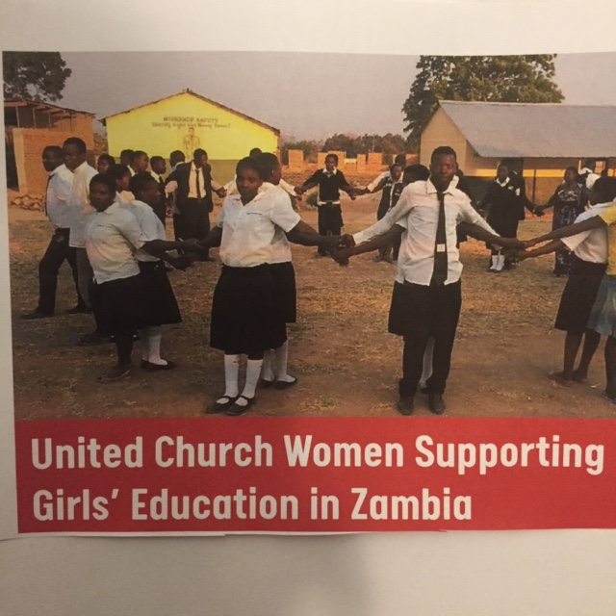
UCW Projects

Slide 8
UCW Projects
Women and Girls Education – Zambia
This project started at the 50th Anniversary and continued until the 55th Anniversary
An amount of over 268K $ was raised for this project

Slide 9
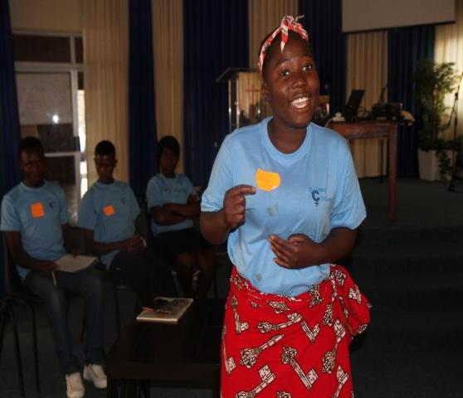
UCW Projects
Women for Change Zambia

Slide 10
UCW Projects
The current project is Women for Change – Zambia
This project started after the 55th Anniversary and will continue until the Celebration of the 60th Anniversary this year.

Slide 11
UCW – M&S

Slide 12
M&S
The UCW has worked and supported the Mission & Service of the United Church for as long as it has existed and continue to do so
The latest figures I have received are for 2020 and the UCW in this region donated 6400$ to M&S

